Slide 1
Sankoff turns 50!! Using Spannoids [k-restricted Steiner Trees] for Sequence Analysis
Videocast August 23rd 2013 from Aarhus to Montreal
Apologies: Absence and Video Cast
String Edits, Time Warps and Macromolecules [Sankoff and Kruskal, 1983]
First time I met Sankoff: Baltimore Spring 1986
Lieberman’s algorithm
Sankoff’s First Talk when I was postdoc
PostDoc with Sankoff 1988-89
I came from Doolittle, went to Gojobori, succeed by John Kececioglou
Notes:
COGANGS – EU Project: collaboration with CLCBIO and BIOBASE
https://genome10k.soe.ucsc.edu

Slide 2
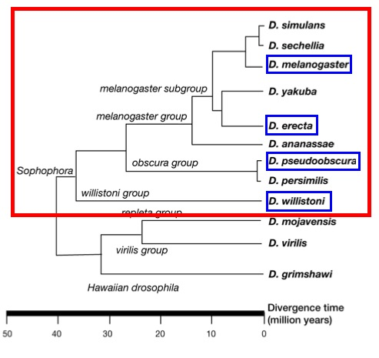
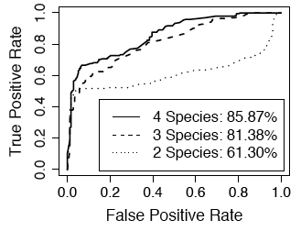
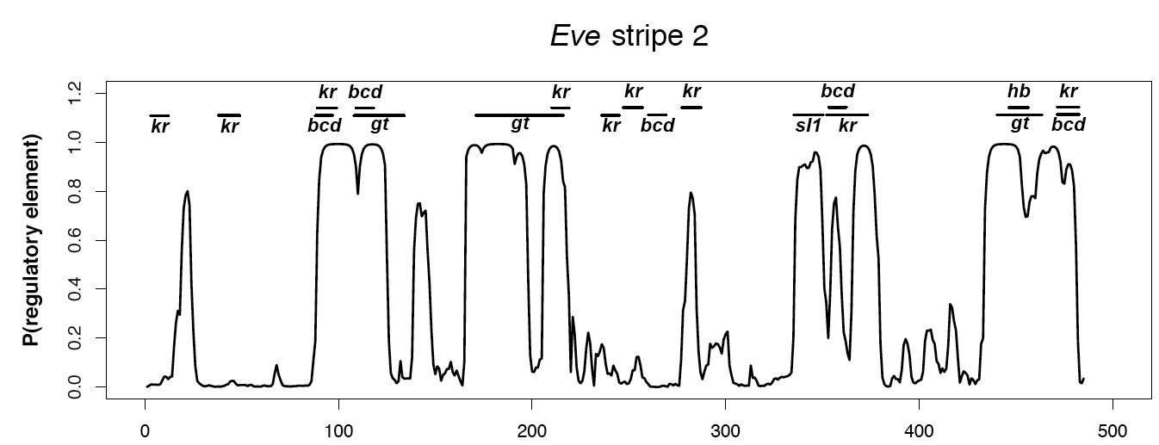
SAPF - Statistical Alignment and Phylogenetic Footprinting
1
2
Target
Alignment HMM
Sum out
Signal HMM
Annotate

Slide 3
Non-biological Genealogical Structures
Fast Statistical Alignment:
Spanning tree
Additional edges
Data – k genomes/sequences:
1
2
1
http://math.berkeley.edu/~rbradley/papers/manual.pdf
2
3
k
4
k
Li-Stephens approximation to recombination-coalescent likelihood
4
3
4
1
2
3
4
1
2
1
2
1
2
1
2
4
3
4
3
4
3
4
3
Spanning Trees (Fitch 1977)
Phylogenetic Networks (Bandelt, Dress, Huson,..)
Spanning Trees (Fitch 1977)

Slide 4
Spannoids – k-restricted Steiner Trees
Baudis et al. (2000) Approximating Minimum Spanning Sets in Hypergraphs and Polymatroids
3
2
1
2
3
4
Spanning tree
1
4
Steiner tree
1
5
1
3
5
3
4
2
4
1-Spannoid
2
6
2-Spannoid
Advantage: Decomposes large trees into small trees
Questions: How to find optimal spannoid?
How well do they approximate?

Slide 5
Approximating Trees
Overall strategy:
Infer full phylogeny
Reduce to Spannoid
There are many k-Spannoids reductions of a phylogeny
Naïve Criteria can lead to imbalanced components
14 optimization criteria were investigated. Some criteria:
Find the k-restricted Steiner tree that minimizes the total length of contracted edges.
Find the k-restricted Steiner tree that minimizes the total number of contracted edges.
Dynamical Programming Algorithms [Rune Lyngsø] optimising different criteria
running time is O(nk²) – n is number of leaves
O(n²+nk²)

Slide 6
Counting k-Spannoids
1. Steiner Trees (Unrooted, leaflabelled & valency 3)
4 | 5 | 6 | 7 | 8 | 9 | 10 | 15 | 20
3 | 15 | 105 | 945 | 10345 | 1.4 10⁵ | 2.0 10⁶ | 7.9 10¹² | 2.2 10²⁰
2. Spanning Trees: k^{k-2}
3. Counting k-Spannoids
k n
0
1
2
3
4
Steiner trees
6
1 296
3 996
5 256
5 706
5 811
105
10
1.0×10⁸
9.7×10⁸
1.8×10⁹
2.3×10⁹
2.5×10⁸
2 027 025

Slide 7
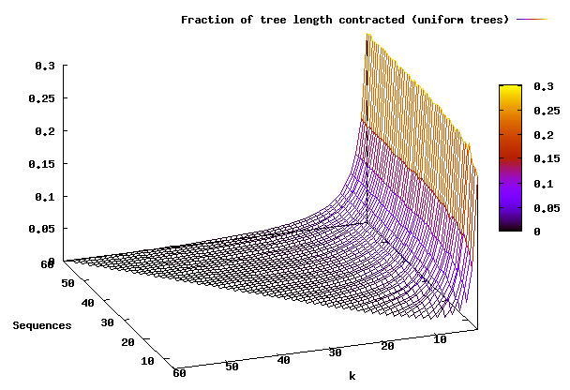
Example – Contraction of Simulated Coalescent Trees
Simulation
Trees simulated from the coalescent
Spannoid algorithm:
Conclusion
Approximation very good for k >5
Not very dependent on sequence number

