Slide 1


Structured prediction:
Input
Output
Handwriting
recognition
exponential size!
brace
Word
alignment
Notes:
.. buzzword for these problem is structured prediction:
given input blah; want to assign a *structured* output...
example --
a key challenge for this is that the number of possibilities for the output is exponential in the size of the input... This is why the traditional approach in machine learning has been to make decisions independently..
-- a key theme in my research is how to exploit efficiently this kind of structure; and for which kinds of structure it is possible..
Moreover -> structured optimization problems...

Slide 2

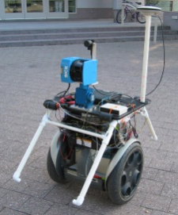
Other examples...
structured error
function:
Input
Output
‘Ce n'est pas
un autre
problème de
classification.’
‘This is not just
another
classification
problem.’
Machine
translation
3D object recognition
building
tree
Laser Range Finder
Notes:
... here are more examples.
MT
in vision, 3D object recognition; depth information recorded by a robot using a laser range finder; want to classify the pixels around it in different categories...
Note that another key aspect of these ‘structure prediction’ problems is that usually we have a structured error functions; i.e., unlike in standard binary classification in machine learning where either you are correct or you are wrong, here you can be wrong quite badly or just a little (e.g. if you only have one word wrong). this information should be used by the learner in some way....
Segbot – from Stanford

Slide 3
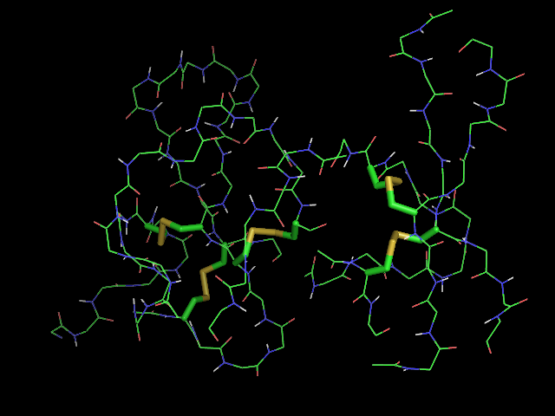
Protein folding
Input
Output
Protein
folding
AVITGACERDLQCG
KGTCCAVSLWIKSV
RVCTPVGTSGEDCH
PASHKIPFSGQRMH
HTCPCAPNLACVQT
SPKKFKCLSK
(slide from Ben Taskar)

Slide 4



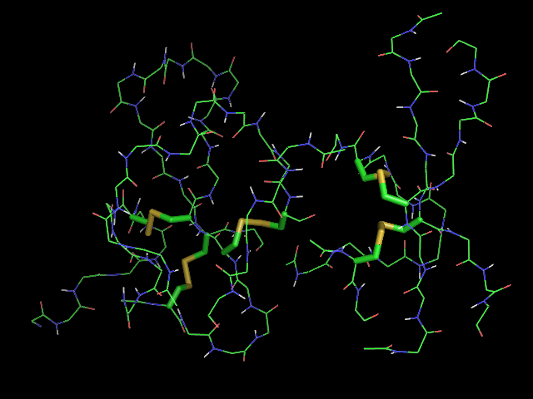
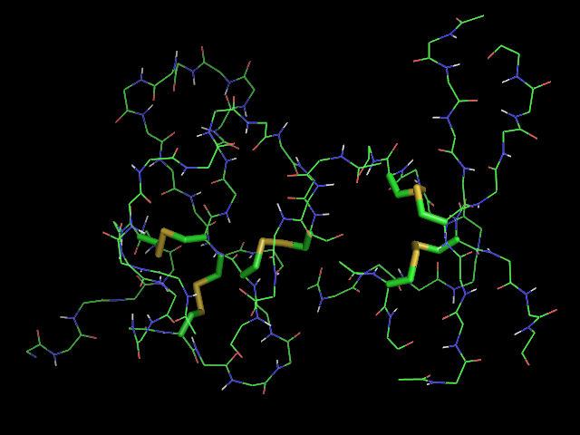

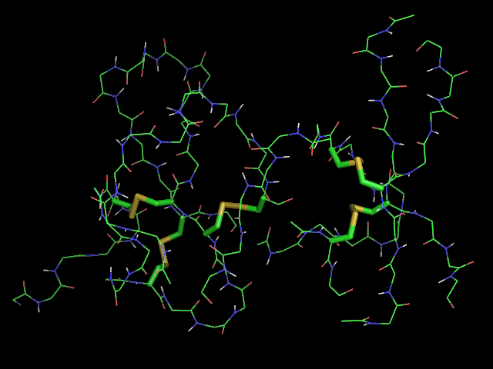
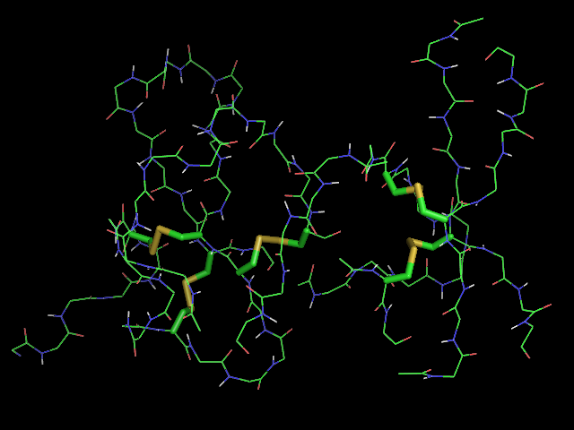
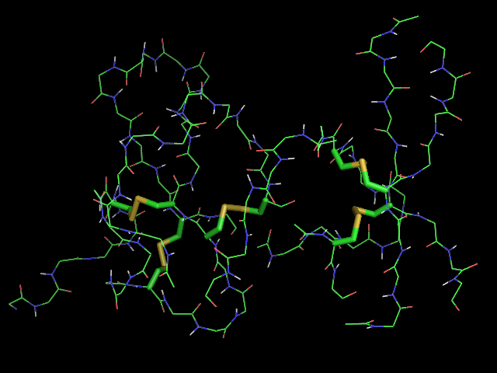

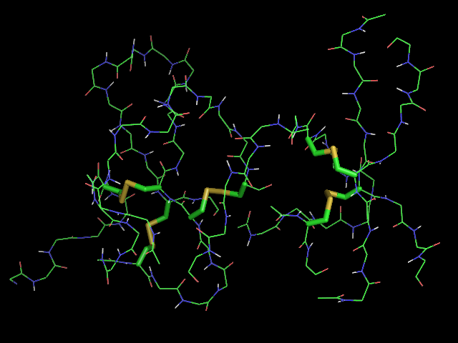


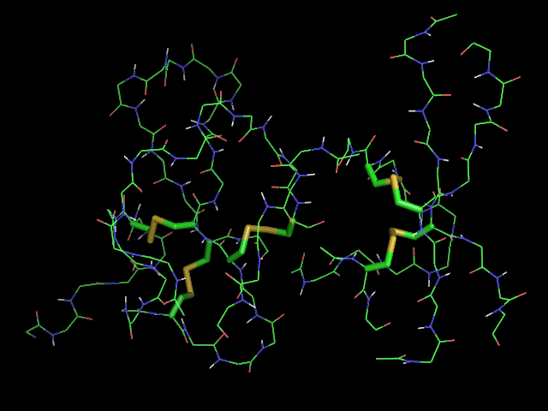


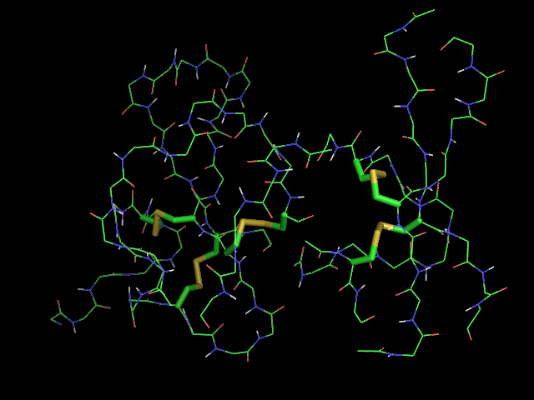
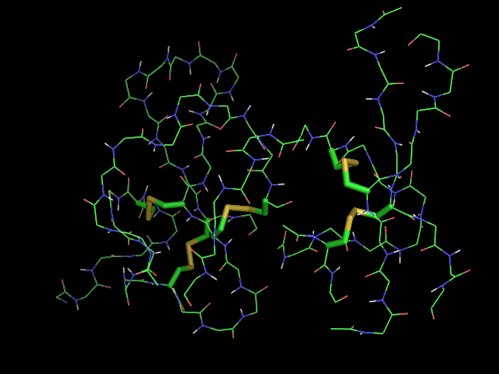
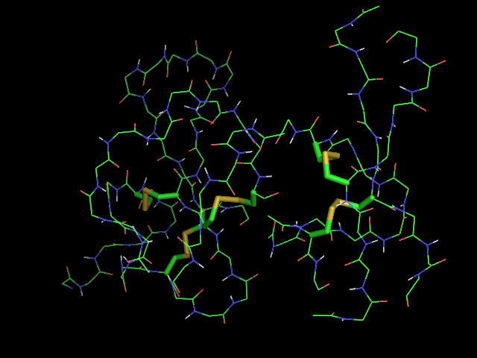
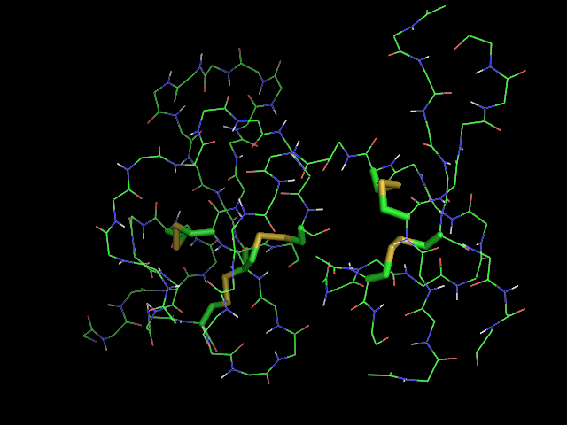
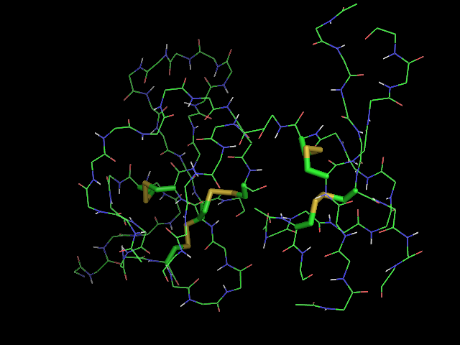
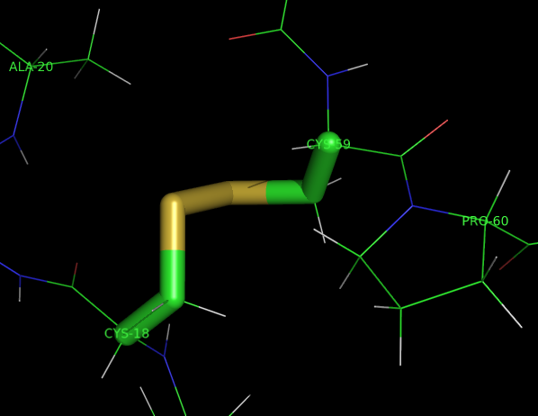
Protein Structure and Disulfide Bridges
AVITGACERDLQCG
KGTCCAVSLWIKSV
RVCTPVGTSGEDCH
PASHKIPFSGQRMH
HTCPCAPNLACVQT
SPKKFKCLSK
Protein: 1IMT
(slide from Ben Taskar)

Slide 5
Disulfide Bridges ⇒ Matching
C C CC C C C C C C
AVITGA ERDLQ GKGT AVSLWIKSVRV TPVGTSGED HPASHKIPFSGQRMHHT P APNLA VQTSPKKFK LSK
AVITGACERDLQCG
KGTCCAVSLWIKSV
RVCTPVGTSGEDCH
PASHKIPFSGQRMH
HTCPCAPNLACVQT
SPKKFKCLSK
(slide from Ben Taskar)

Slide 6
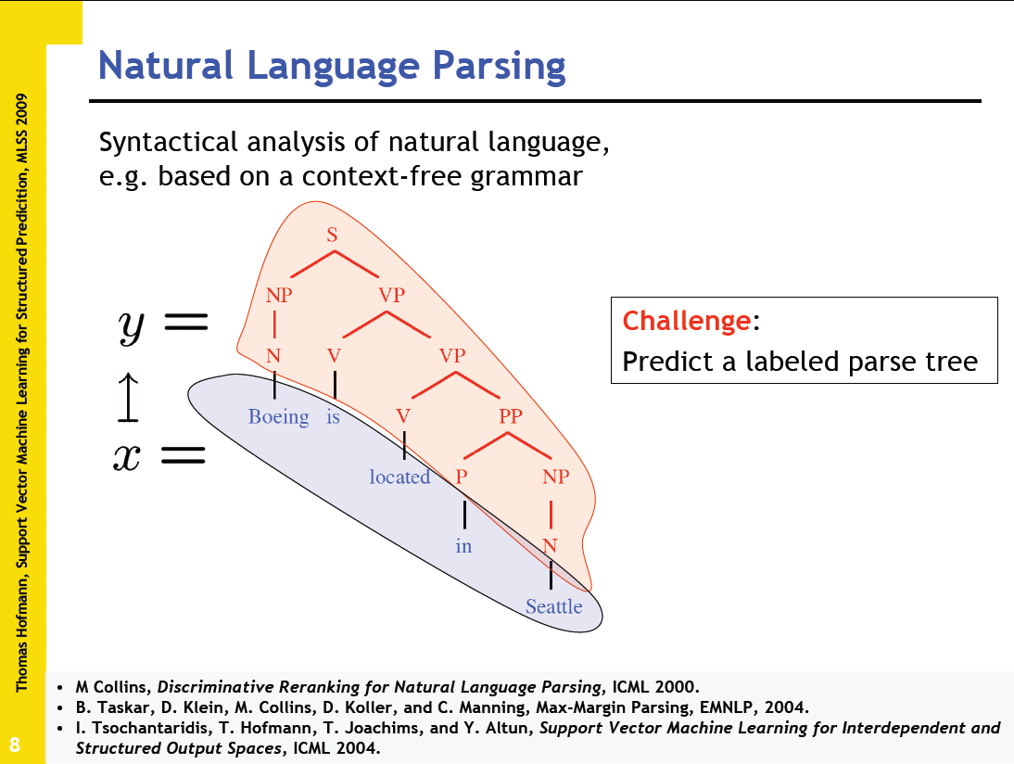

Slide 7
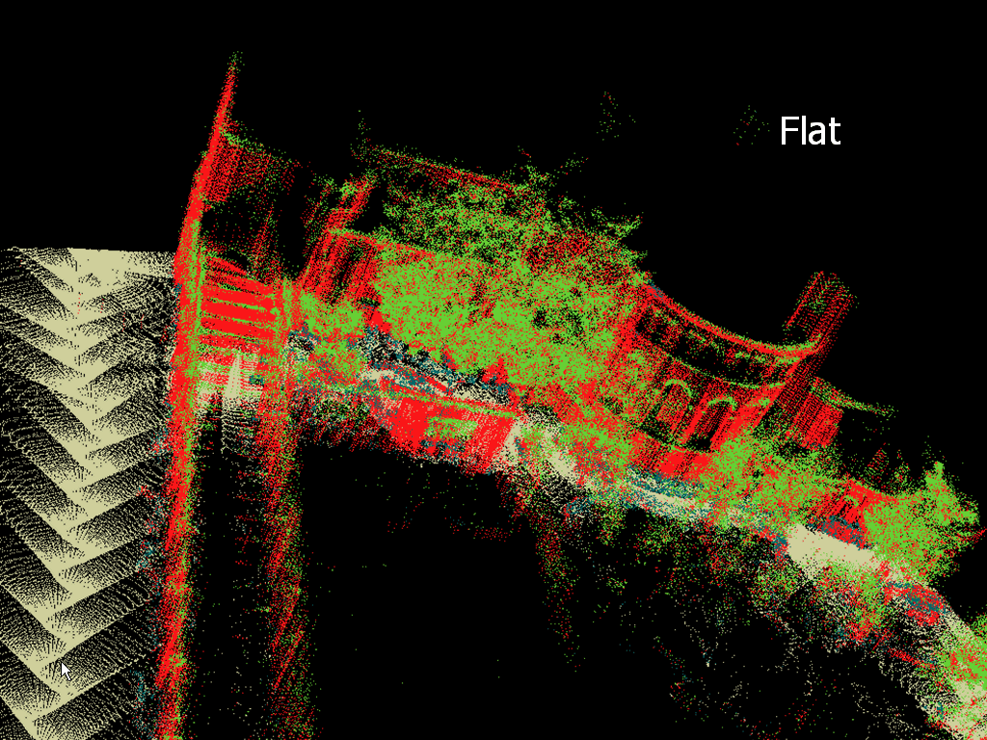
3d object recognition (local)
building
tree
shrub
ground
(slide from Ben Taskar)

Slide 8
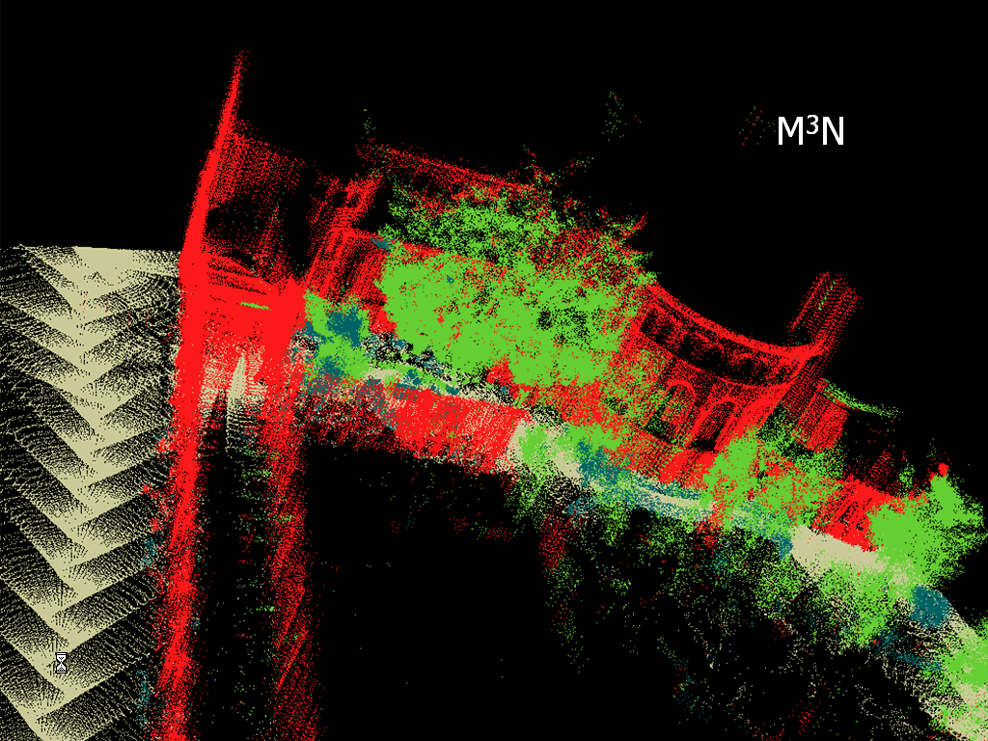


3d object recognition (joint)
building
tree
shrub
ground
(slide from Ben Taskar)

