Slide 1
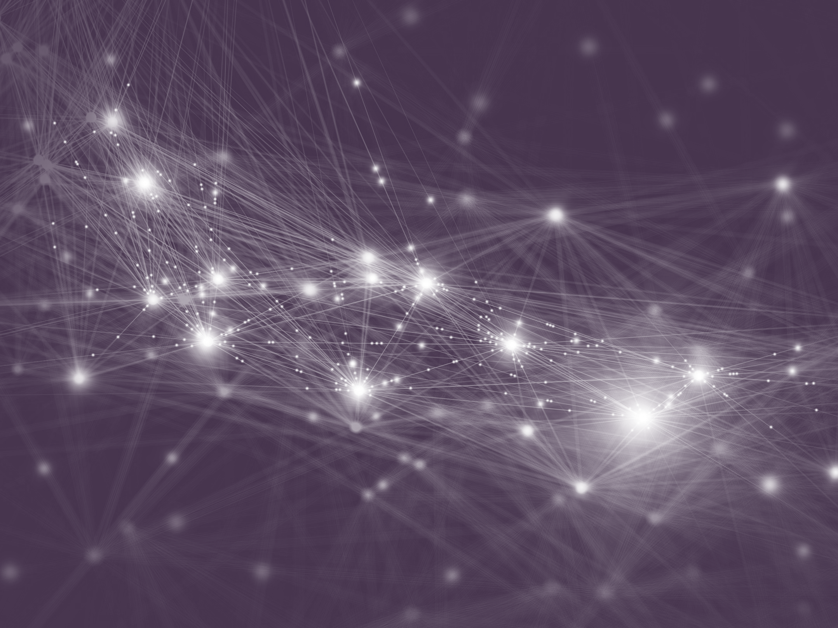




Sources of Richness and Ineffability for Phenomenally Conscious States
Yoshua Bengio
ASSC’2023
June 25th, 2023 (remote talk)
Notes:
25 min talk + 5m Q/A
Current neural networks, such as large language models and those based on images or paired images and text, are trained to fit their training data, with very little in their architecture that could force them to produce answers that are coherent with respect to individual pieces of knowledge. In that sense, they seem to be missing some of the reasoning abilities and causal understanding that humans can benefit from, and this may result in incoherent outputs and mistakes that humans would typically not make, especially out-of-distribution. This raises the larger question of how higher-level cognitive abilities could be incorporated in deep learning. We know a lot from neuroscience and cognitive science about them and that can be used to design new architectures and training frameworks with the corresponding inductive biases. This has motivated a novel form of deep learning called generative flow networks or GFlowNets, borrowing from reinforcement learning, generative models and amortized variational inference. GFlowNets can sequentially generate compositional data structures whose content may be analogous to our thoughts, and they can be trained to sample them with probability proportional to some given or learned reward function that corresponds with the coherence of the context and generated answer with a structured world model. A GFlowNet can thus be trained to perform amortized probabilistic inference that is consistent with the pieces of knowledge of the world model, including in the sense of generating samples from a Bayesian posterior over world models. Like with amortized variational methods, this can be used to learn the world model itself. That arrangement is similar to model-based reinforcement learning (where we separate the policy from the world model) but concerns the learning of a policy that chooses what internal computation (i.e. reasoning) to perform, rather than acting in the world. Unlike with state-of-the-art deep learning and reinforcement learning, this makes it easy to incorporate inductive biases about high-level cognition and causality in the world model itself, such as sparse causal dependencies and reusable modular pieces of knowledge. It means that the GFlowNet probabilistic inference machine can be trained by querying the world model, without having to directly interact with the real world, and can be as large and trained with as many queries as our computational capabilities allow: unlike current deep nets, its effective capacity is not limited by the size of the externally observed data. This is convenient because probabilistic inference is generally intractable and may thus require high capacity in order to be approximated with a fast neural net. The mathematical foundations of GFlowNets and how they constitute an interesting ML-based alternative to MCMC inference will be briefly explained and recent work on GFlowNets highlighted.

Slide 2


What is missing from gpt-4?
  Human-like reasoning, inner imagination and planning
  Causal discovery and causal reasoning
  Providing high-level explanation and sources of facts
  Generalizing better far from its (huge) training set (OOD generalization)
  Generalizing well with less data (10000 human lives spent reading?)
2
Notes:
Include such a list at the beginning and as reminder along the way, roadmap

Slide 3
What is human-like reasoning?
Inference (believed to be approximately Bayesian)
Composing pieces of knowledge (to explain, plan, imagine, learn)
  Which requires factorizing knowledge into composable pieces
Global Workspace Theory (GTW) bottleneck
  Thought: like a short sentence, very few concepts
  Hard stochastic choice: inference over a few latent elements
  Train of thoughts: incomplete inner story, but very informative
Necker cube is bistable
3
Notes:
Include such a list at the beginning and as reminder along the way, roadmap

Slide 4
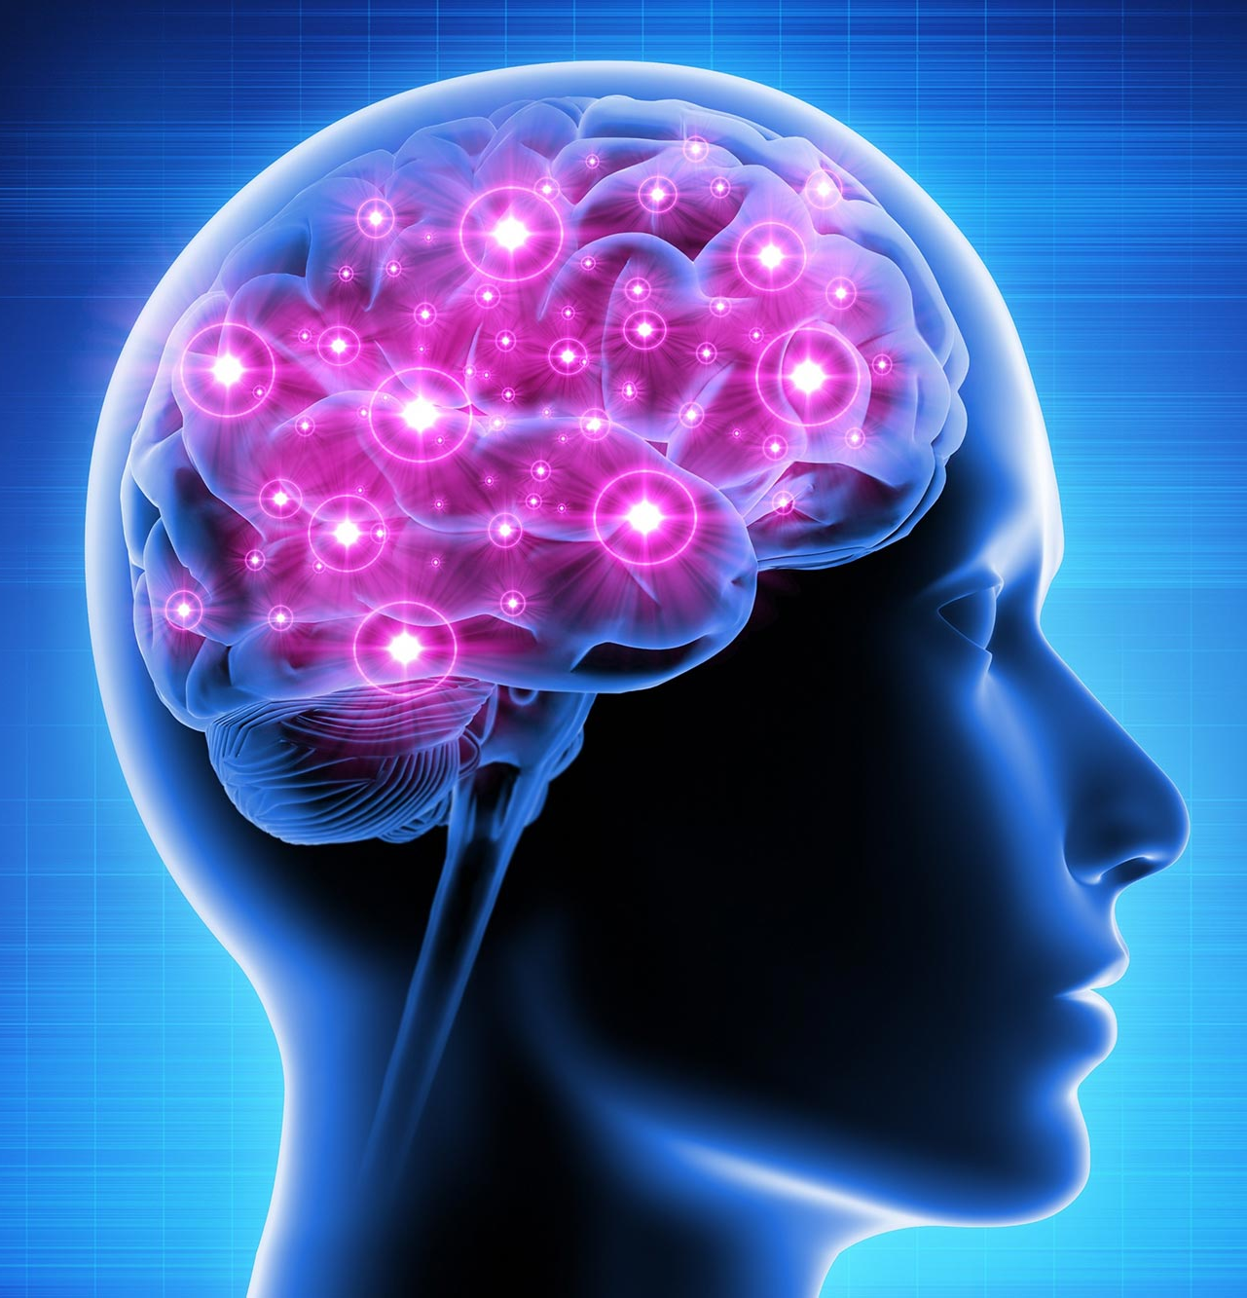
UNIQUE CAUSE FOR The GAP: CONSCIOUS PROCESSING?
  Hypothesis:
  This gap originates from a type of computation, knowledge representation and inference associated with conscious processing in humans, not yet mastered in AI
4
Notes:
Include such a list at the beginning and as reminder along the way, roadmap

Slide 5
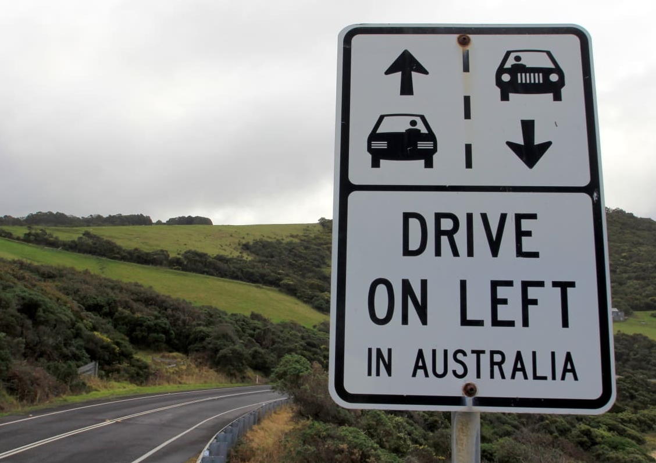

Conscious processing helps humans deal with OOD SETTINGs
Faced with novel or rare situations, humans call upon conscious attention to combine on-the-fly the appropriate pieces of knowledge, to reason with them and imagine solutions.
→ we do not follow our habitual routines, we think hard to solve new problems.

Slide 6
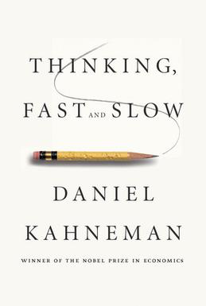


System 1 vs. system 2 cognition
2 systems (and categories of cognitive tasks):
Manipulates high-level / semantic concepts, which can be recombined combinatorially
System 1
  Intuitive, fast, UNCONSCIOUS, 1-step parallel, non-linguistic, habitual
  Implicit knowledge
  Current DL
System 2
  Slow, logical, sequential, CONSCIOUS, linguistic, algorithmic, planning, reasoning
  Explicit knowledge
  DL 2.0
6

Slide 7

WORKING memory bottleneck for SPARSE DEPENDENCIES
Consistent with Global Workspace Theory
Linguistic example: "if I drop the ball, it will fall on the ground”
inertia mechanism
EFFECT
Ball position
at t₀
Ball position
at t₁
Drop ball
Dropping mechanism
An abstract outcome can be predicted accurately from very few conditioning abstract variables
INTERVENTION
(gates mechanisms)
Hand holding
at t₀
Drop action
CAUSE

Slide 8
GWT ATTENTION & INFERENCE Policy
  Stochastic transition = new thought
  Attention = competition between possible thoughts in context
  Stochastic hard decision among competing thoughts
  Winning thought from cooperation (e.g. one sentence = cooperation of words)
  Many thoughts are compatible with context but only one is selected (incomplete inference over latent variables)
8
Notes:
Include such a list at the beginning and as reminder along the way, roadmap

Slide 9
Probabilistic neural nets for system-2 deep learning?
Need generative neural nets of thoughts to represent and sample from Bayesian posterior over latent variables, explanations, theories, plans, causal structure, etc.
Taking stochastic hard decisions about interpretations/plans/etc = prob. Inference
Can be trained not with the data as input/output examples but instead to sample models from a distribution proportional to prior(model) x likelihood(data|model), i.e., from an infinite number of "examples" that are candidate models.

Slide 10
Compressed world model / large inference machine
Biological evidence of MDL compression in working memory suggests the brain generates compact world model and explanation of the world
Human fast adaptation suggests a low MDL representation of knowledge, but exact inference may still be intractable
But the richness of the inference machinery is not limited by the amount of actual data
Inference machine over models can be trained by being consistent with data and prior, as much as computational resources permit
Current deep learning confounds world model & inference, yielding an incompatible capacity between inference machine and knowledge

Slide 11


How Could brains generate trains of thoughts?
What may it tell us about subjective experience?
Xu Ji, Eric Elmoznino, George Deane, Axel Constant, Guillaume Dumas, Guillaume Lajoie, Jonathan Simon, Yoshua Bengio, "Sources of Richness and Ineffability for Phenomenally Conscious States", ArXiv:2302.06403
11
Notes:
Include such a list at the beginning and as reminder along the way, roadmap

Slide 12
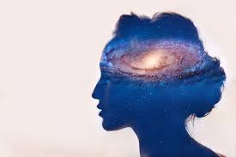
Subjective experience & consciousness
  Rich debates in philosophy, cognitive science and neuroscience, especially about the unreported aspects of our conscious state: subjective experience, qualia, phenomenal experience, etc.
12
Notes:
Include such a list at the beginning and as reminder along the way, roadmap

Slide 13
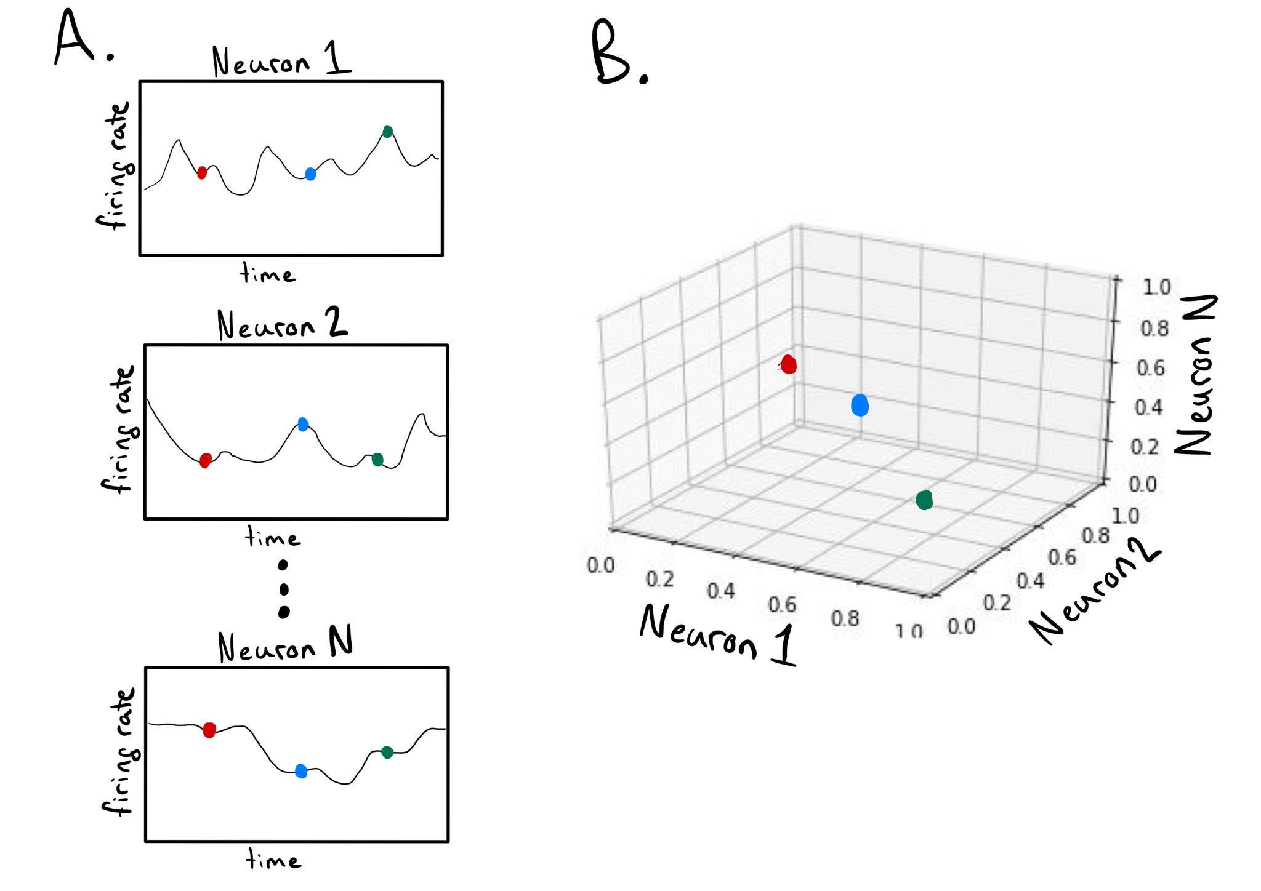
The brain as a dynamical system
  Neural state and dynamics
  High-dimensional vector: 10¹¹
13
Notes:
Include such a list at the beginning and as reminder along the way, roadmap

Slide 14
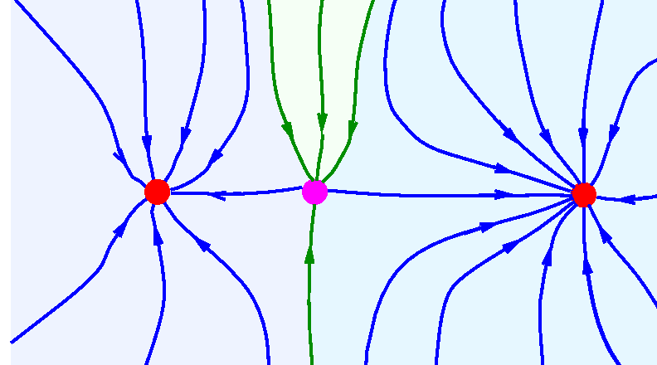
The brain as a dynamical system
  Contractive dynamics:
  2 nearby states get closer after one small time step
  Attractors = asymptotic destination of all trajectories
  Basin of attraction of attractor A:
  all states destined to the same attractor A
  Transient states X form trajectory
  into attractor A
14
Notes:
Include such a list at the beginning and as reminder along the way, roadmap

Slide 15
The brain as a dynamical system
  The brain state is either in one basin of attraction or another
  The set of attractors is discrete!
  they are mutually exclusive = attention
  Because of high-dimensionality,
  attractors can be identified by
  a composition of symbols (e.g. phrase).
  Number of attractors can be exponentially large.
15
Notes:
James Kozloski

Slide 16
Working memory as sustained STABLE state
  Biological evidence:
    Conscious states are sustained over 100ms (Dehaene & Naccache 2001)
    Awareness associated with stable states (Schurger et al 2015)
    Only sustained states are stored in working memory, and later, short-term memory, using positive feedback (Barak & Tsodyks 2014; others) and suppression of inputs and of parts of cortex (Wang 2008; others)
    Attractors reliably store bits of information (identity of the attractor) and RNNs trained for remembering develop contractive attractors
Sussillo & Barak 2013
16
Notes:
Include such a list at the beginning and as reminder along the way, roadmap

Slide 17
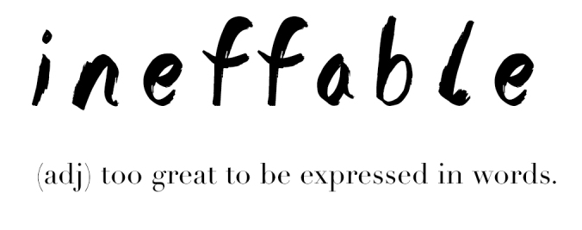
Richness & ineffability of subjective experience
  Transient states and attractor embeddings live in R¹⁰ , which is so huge that it is not communicable
  May partially explain the impression that we experience something richer than our report, that our conscious experience is
    rich
    ineffable
    fleeting
    personal
  This would make subjective experience a side-effect of the thinking machinery
  ¹¹
17
Notes:
Include such a list at the beginning and as reminder along the way, roadmap

Slide 18
Working memory & reporting
  Report & discreteness: our linguistic reports and ulterior memories of these thoughts suggest that working memory content has a strongly discrete quality. Something is also lost between our immediate subjective experience and our memory of it.
Note: prototypes can be learned (sometimes in one shot) and associate a symbol with a fairly high-dimensional continuous representation (e.g. a face).
18
Notes:
Include such a list at the beginning and as reminder along the way, roadmap

Slide 19
Stochastic hard ATTENTION with attractor dynamics
Necker cube is bistable
Neural and synaptic noise → randomly selected attractor
Chaotic dynamics → sensitivity to initial conditions (pseudo-randomness)
= stochastic hard attention
GFlowNet: mathematical abstraction to specify how to learn the corresponding stochastic policy for probabilistic inference (see online tutorial).

Slide 20



LOSS OF information from bob to alice
  Let i(A) be the implicit table (given by the dynamics) that maps an attractor A to its discrete identity i (representable with a composition of symbols), and let T[i(A)]=A be the table whose rows are the attractor embeddings (e.g. fixed point state) of all the possible attractors.
If Alice is truthful and fully expresses her thought, M=i(A)
A
A’
Message M="red"
20
Notes:
Include such a list at the beginning and as reminder along the way, roadmap

Slide 21
LOSS OF information from bob to alice
  T[] and i() are inverse of each other implemented by language areas but only known to subject Alice. When Alice converts i(A) into a message M, and Bob receives M, it will evoke a new attractor A’ in his brain. Because Bob does not know T[] or i() from Alice, he is not able to get all the subtle associations Alice makes with M.
A
A’
M="red"
It is useful for Alice to be aware that Bob does not have access to her personal semantic table T, i.e., she must be aware of the semantic gap between them, to plan accordingly.
21
Notes:
Include such a list at the beginning and as reminder along the way, roadmap

Slide 22
Chain of information loss
  Alice’s sensory signal S →
  unconscious part of brain state U →
  transient brain state X during the formation of a working memory content →
  attractor state A →
  discrete identity of attractor state i(A) →
  memory or message M →
  Bob’s S’ → Bob’s U’ → Bob’s X’ → Bob’s A’
  The biggest losses (if Alice is truthful about her thought) are
  from X to A (discretization) and
  from M to A’ (Bob doesn’t know Alice’s brain dynamics or semantics T)
22
Notes:
Include such a list at the beginning and as reminder along the way, roadmap

Slide 23
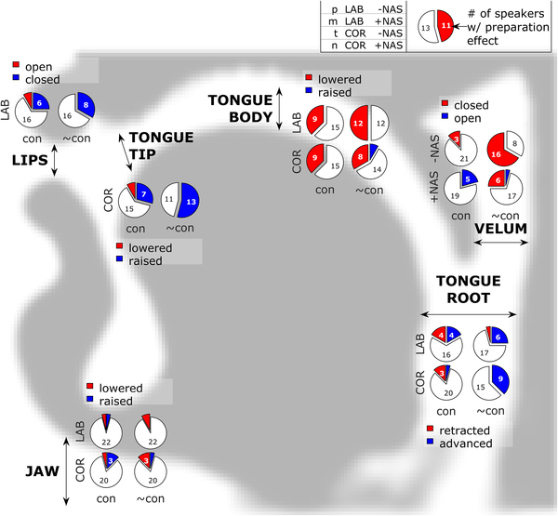
FLUID TRANSITIONS BETWEEN ATTRACTOR BASINS
Vocal tract configurations approach but do not reach attractors, fluidly moving towards one and then another
  easily decoded without requiring convergence to the attractor: speed gain!
Dynamics are driven by changing context, which can pull up or down attractors that are more relevant by driving the dynamics.

Slide 24
Open questions
  Where is the boundary between unconscious and conscious?
    Is the transient state part of subjective experience or just the attractor state?
    Subjective experience contains richness which is lost in the associated memory, which suggests that the transient state is part of subjective experience. That would also fit with the impression of fluidity of our trains of thoughts.
  How is the brain state converted to working memory and broadcast?
    Sustained states may facilitate synaptic adaptation of fast weights (temporary memory)
  Plasticity → changes in dynamical system → how to avoid loss of memory?
  How do we test this theory?
    AI implementations
    Neuroscience experiments?
  How does it relate with other theories of subjective experience?
    May be complementary to Attention Schema Theory.
24
Notes:
Include such a list at the beginning and as reminder along the way, roadmap

Slide 25
Consciousness risks
  Many of us have a strong impression that there is a special non-material spark in us
  The arguments here suggest that the hard problem, subjective experience, may have a mathematical explanation to implement working memory and system 2
  We also have a strong tendency of anthropomorphizing and attributing consciousness
  We are approaching human-level AI and along the way we will get fooled more and more. If we understand the mechanism of subjective experience, we could choose or not to put them in AI.
  An important aspect of consciousness is also self-awareness and our self-preservation instinct: putting that into machines could be very dangerous, introducing a new kind of species that could be smarter than us, posing existential risks
25
Notes:
Include such a list at the beginning and as reminder along the way, roadmap

Slide 26

Questions?

