Slide 1




Towards Quantitative Safety Guarantees and Alignment
December 11th, 2023
Alignment Workshop, New Orleans
Yoshua Bengio
Notes:
45min + 15 min q&a

Slide 2
Two Requirements to Avoid AI Catastrophes
Solving the alignment & control challenge: a technical challenge + political challenge (massive investment in R&D)
Solving the coordination challenge: making sure safe and ethical protocols are followed, and preparing in case a rogue AI emerges nonetheless, a socio-technical challenge

Slide 3
Misalignment Harms
Unintended misalignment → unethical AI, offensive AI, discriminative AI, unfair AI-driven decisions, privacy violations
Unintended misalignment → facilitates misuse in the hands of bad actors (e.g. thanks to open-source + fine-tuning undoing safety)
  Disinformation
  Cyberattacks
  Bioweapons
  Chemical weapons, etc
Unintended misalignment → facilitates creating runaway AI, with dangerous self-preservation goals

Slide 4
Coordination Harms
Open-source debate: irreversible proliferation, escapes purview of regulator, handing dangerous weapons to bad actors – consider alternatives to full open-source release + democratic governance
Frankenstein scenario: people who value intelligence above all else and are happy to welcome humanity's succession, SAI; intentionally providing primary self-preservation goal to SAI
Societal collapse: e.g., collapse/instability of democracies/economies, willingly handing over gradually more control to AIs because of competition (economic, military, etc)

Slide 5

Democracy vs Power Concentration
AI in a few hands = power concentration
Increased AI capability = increased power concentration
Powerful AI in a few (public or private) hands = extreme power concentration = capacity to profoundly influence, destabilize or dictate political, social, military and economic agendas
Unintended consequences, e.g., job market disruptions
→ Future Frontier AIs can threaten social order and markets
EVEN IF WE SOLVE SAFETY/ALIGNMENT
Democratic governance needed, with civil society & international representation / role of UN

Slide 6
What we can do to mitigate harms & risks?
3 recommendations in testimony to US senate (July 2023):
National regulation + international treaties, reducing access and frontier development to licensed organizations & registered models, with audits, banning models not proven safe
Major research investment in AI safety, to better understand risks and guide regulation (what threshold for danger? How to evaluate and benchmark risks?)
Plan B against the eventual emergence of AI-driven threats from misuse or loss of control (countermeasures)

Slide 7
How to Counter a Superhuman AI?
Imagine cyberattacks or bioweapon attacks by superhuman AI
We need another AI helping us design better defenses and monitoring, that can battle it out with the attacking AI
But
It needs to be safe, secure & in safe hands:
  no runaway AI due to loss of control / misalignment
  no leak / takeover by power-seeking humans → democratic governance is crucial
Defense may be more difficult than attack
Ideally, defense AI is more advanced than the attacking AI

Slide 8
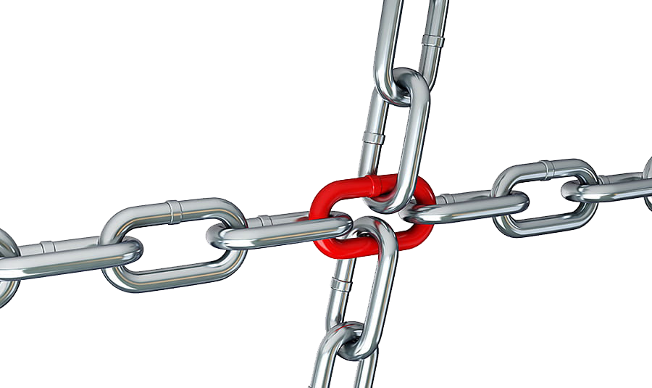
Avoiding the single point
of failure
How can a democratic humanity be
sustainable when superhuman AI systems can be built?
A single individual, corporation or government with too much control over a very powerful AI system could accrue so much power that others cannot stop them anymore
An individual, corporation or government could make a mistake or play Frankenstein → autonomous rogue AI, new dominant species
Powerful AIs must be under very strong and inclusive (civil society, media, academics, governments) democratic governance

Slide 9
Proposal: A Multilateral Network of Classified AI Countermeasures Research Labs
To avoid single point of failure, across multiple like-minded democracies
Collaborate w/ governments for national security expertise and deployment
Labs share their advances within the network: robust in case one of the labs becomes rogue (due to humans seeking power or loss of control to rogue AI), balancing force from the others
Labs operate under a strong democratic governance and safety and security protocols to minimize such risks & define multilateral democratic mission & oversight
Research efficiency through independent research directions
Multilaterally shared mission: AI safety/alignment + countermeasures, only defensive, to mitigate AI arms race

Slide 10
Democratic governance of non-profit non-governmental countermeasures AI labs
Why non-profit but government-funded?
  Profit maximization = economic dominance
  Profit maximization conflicts with safety & democratic governance
  Economic competition among labs = not sharing results = greater danger of catastrophic single point of failure
Why non-governmental &multilaterally funded?
  Gov. admin. too rigid & constrained, need startup-like environments
  Risk of takeover by power-seeking government
  Reduce risk of country-level AI race by setting defense goals only
  Lab must follow multilaterally decided democratic governance

Slide 11

The danger with RL and maximizing rewards
Estimated value/reward/model could be wrong
Greatest misalignment danger: great harm seen as great reward
Maximizing reward
→ likely to discover such major mismatches
→ amplifies misalignment!

Slide 12
RL evil: Maximizing misalignment
Consider two functions:
  the real & the estimated reward functions.
May statistically match well on a random test set
However, maximizing the estimated one is likely to uncover the greatest mismatches
  Too good to be true
We need CIRL-like solutions: human intentions = latent variable

Slide 13
How RL + Compute Power = Reward Hacking
Consider an agent that receives a reward from a human and optimizes its policy to maximize its expected reward
Cohen et al. (2022):
  This necessarily yields reward hacking as the compute power to optimize the policy increases, even in the CIRL case
Cohen, Hutter & Osborne. "Advanced artificial agents intervene in the provision of reward." AI magazine 43, no. 3 (2022)

Slide 14
How to build a useful & harmless AI?
Non Agentic Solution: AI Pure Scientist:
  Neural net generates theories about the world (writes scientific papers)
  Theories sampled from approximate Bayesian posterior P(theory | data)
  Theories include latent causal explanations for the data
  No goal (except as an object of study), no reward
  Builds a really good world model with epistemic humility
  Does not optimize for long-term goals
  May help human scientists a lot, help with UN SDGs
  NOT AN ORACLE: answering questions would require marginalization and optimization
  But cannot be an agent to help us fight Rogue AIs "live"

Slide 15
The Problem with Maximum-Likelihood Models
Current Frontier AI approaches combine maximum likelihood training with RL
May be wrong with confidence in some places (hallucinations!)
Optimizing on such model discovers fantasy treasures
Absolutely no quantitative safety guarantees!

Slide 16



Bayesian Posteriors for Safe Uncertain Decisions
Maximum likelihood model: 25% chances of dying
Bayesian agent: 50% cake, 50% nothing
2 theories compatible with previous data
Causality theory: even with infinite data, likely ambiguity of causal graph = Markov Equivalence Class

Slide 17
Provable Safety for AI Agent: Rejecting Unsafe Actions with Quantitative Guarantee
Current evals are spot checks, no guarantees in new contexts
Given observed data D, context x, what would be the probability of harm resulting from action a?
Reject action if P(harm | action, x, D) > threshold
How could we efficiently estimate such Bayesian posterior probabilities in a conservative way? We cannot afford to underestimate it if the harm is catastrophic.

Slide 18
Bayesian Posteriors
    Given prior over explanatory theories, with specifying how to answer any question, e.g., tells us how to compute any likelihood per-example or over dataset,
    Estimate
    where (x,y) are any subset of r.v.
    may include latent explanatory variables values
1. sampling
2. marginalizing

Slide 19
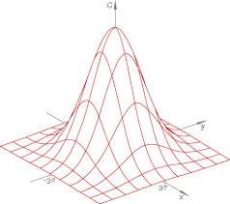

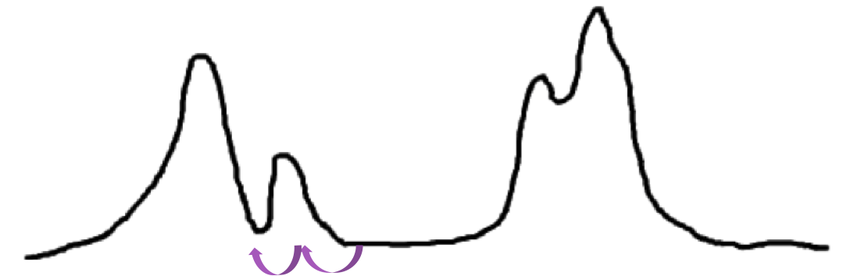
The Limitations of MCMC Methods
Systematic generalization
MCMC makes a large number of small, noisy, local moves generally towards higher probability
Asymptotically samples from
P(x) exp(-energy(x))
But exponential time to mix between modes which occupy a small volume and are far from each other.
?

Slide 20
Objective: Increase Compute → Increase Safety
In principle MCMC would do but may not scale practically to Frontier AI world models.
Large neural net amortized inference approaches Bayesian posterior as the neural net size and training time increase
We need neural nets that can flexibly represent rich Bayesian posteriors.

Slide 21
Why Rich Amortized Predictors?
Compositional structure → exponential # modes
With MCMC, difficult to mix between modes
Traditional variational inference → single mode-seeking
ML predictors may generalize from a small fraction of visited modes by exploiting generalizable structure
GFN implicitly marginalizes over exponential # modes
Amortized predictors are fast at run-time

Slide 22
Modes of the Bayesian Posterior
Cannot be parametric: cannot afford to put 0 mass on reality
Can we guarantee that we'll get all the modes of the posterior?
  No, in general
  Unless we restrict ourselves to theories about the world harbored by humans
  In that case our safety guarantee is not much worse than that of the human theory with the best fit to the data

Slide 23
GFlowNets & Bayesian posteriors
Learn a generative policy that samples compositional objects proportionally to some given reward function (a function of the generated objects).
Different from standard generative models, that learn from data
If the reward function is the prior over theories times the likelihood of the data under the theory, then the GFlowNet learns to sample from the Bayesian posterior over theories:

Slide 24
Jointly Learning to Sample & Marginalize
What if no sampler is given? e.g. Bayesian normalization constant
Train a posterior sampler & S:
To satisfy constraint:
Using a GFN loss:
(x,y) not necessarily real data
Recover posterior prob., sampler and normalizing constant.
Can be trained off-policy, from any full-support distribution.

Slide 25
Generating Compositional Objects Sequentially
If y is a complicated object, representing its multimodal distribution efficiently can be done through a sequence of stochastic actions.
Let be the resulting action-state trajectory, with forward policy (to generate a final state ) and backward policy (to generate a trajectory given a final state y):
Turned into a GFN loss:

Slide 26
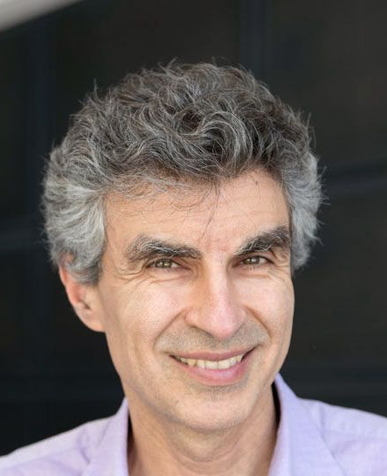
Bayesian Structure Learning with Generative Flow Networks
UAI’2022, arXiv:2202.13903
Tristan Deleu, António Góis, Chris Emezue, Mansi Rankawat, Simon Lacoste-Julien, Stefan Bauer, Yoshua Bengio

Slide 27

NeurIPS 2023, Deleu et al,
Joint Bayesian Inference of Graphical Structure and Parameters with a Single Generative Flow Network
  Generate a causal graph G sequentially while satisfying DAGness constraints exactly
  Generate parameters | G (implicitly conditioning on data X)
27
Notes:
Include such a list at the beginning and as reminder along the way, roadmap

Slide 28
GFlowNet Tutorial
https://yoshuabengio.org/gflownet-tutorial
Papers at NeurIPS 2021, ICML 2022, UAI 2022, NeurIPS 2022, ICLR 2023, ICML 2023, NeurIPS 2023 + ArXiv
Notes:
https://tinyurl.com/gflownet-tutorial

Slide 29
Enforcing Interpretability of Theories
We could add autoencoding-like losses to enforce interpretability of the theories and partial theories and individual latents generated by the Bayesian posterior.
  To check that the AI's theories make sense to humans
  To help human scientists grow their understanding of the world
  To convert into a logical form statements in natural language that are meant to represent something true or false and vice-versa (e.g., such action is harmful)
Does not necessarily limit the AI theories because the theories can include definitions of new concepts

Slide 30
Obtaining Conservative Robustness
What if the correct theory is the only one to predict harm out of a continuum of incorrect theories that are also compatible with the data?
  We need to be more conservative and use amortized adversarial methods (your paranoid self) to generate (implicitly search for) theories that predict major harm among those that fit the data
How to account for the imperfections of the neural net estimator of the posterior?
  Use the losses to estimate a confidence interval around the estimated log-probs and act accordingly conservatively

Slide 31
Challenges towards an Aligned AI
Demonstrate safety bounds with exact Bayesian posteriors
How do GFlowNet losses translate into safety bounds?
Missing modes may always be a problem, but in principle we could at least include all human theories in the posterior
Scaling GFN-like inference to mega-scale is required, may work if, like humans, the GFN only emits partial theories

Slide 32

Questions?
Thank you for your attention and taking the time to digest all this!

