Slide 1
Traditional IR models
Jian-Yun Nie

Slide 2
Main IR processes
Last lecture: Indexing – determine the important content terms
Next process: Retrieval
How should a retrieval process be done?
Implementation issues: using index (e.g. merge of lists)
(*) What are the criteria to be used?
Ranking criteria
What features?
How should they be combined?
What model to use?

Slide 3
Cases
one-term query:
The documents to be retrieved are those that include the term
Retrieve the inverted list for the term
Sort in decreasing order of the weight of the word
Multi-term query?
Combining several lists
How to interpret the weight?
How to interpret the representation with all the indexing terms for a document?
(IR model)

Slide 4
What is an IR model?
Define a way to represent the contents of a document and a query
Define a way to compare a document representation to a query representation, so as to result in a document ranking (score function)
E.g. Given a set of weighted terms for a document
Should these terms be considered as forming a Boolean expression? a vector? …
What do the weights mean? a probability, a feature value, …
What is the associated ranking function?

Slide 5
Plan
This lecture
Boolean model
Extended Boolean models
Vector space model
Probabilistic models
Binary Independent Probabilistic model
Regression models
Next week
Statistical language models

Slide 6
Early IR model – Coordinate matching score (1960s)
Matching score model
Document D = a set of weighted terms
Query Q = a set of non-weighted terms
Discussion
Simplistic representation of documents and queries
The ranking score strongly depends on the term weighting in the document
If the weights are not normalized, then there will be great variations in R

Slide 7
IR model - Boolean model
Document = Logical conjunction of keywords (not weighted)
Query = any Boolean expression of keywords
R(D, Q) = D →Q
e.g. D₁ = t₁ ∧ t₂ ∧ t₃ (the three terms appear in D)
D₂ = t₂ ∧ t₃ ∧ t₄ ∧ t₅
Q = (t₁ ∧ t₂) ∨ (t₃ ∧ ¬t₄)
D₁ →Q, thus R(D₁, Q) = 1.
but D₂ →Q, thus R(D₂, Q) = 0.
/

Slide 8
Properties
Desirable
R(D,Q∧Q)=R(D,Q∨Q)=R(D,Q)
R(D,D)=1
R(D,Q∨¬Q)=1
R(D,Q∧¬Q)=0
Undesirable
R(D,Q)=0 or 1

Slide 9
Boolean model
Strengths
Rich expressions for queries
Clear logical interpretation (well studied logical properties)
Each term is considered as a logical proposition
The ranking function is determine by the validity of a logical implication
Problems:
R is either 1 or 0 (unordered set of documents)
many documents or few/no documents in the result
No term weighting in document and query is used
Difficulty for end-users for form a correct Boolean query
E.g. documents about kangaroos and koalas
kangaroo ∧ koala ?
kangaroo ∨ koala ?
Specialized application (Westlaw in legal area)
Current status in Web search
Use Boolean model (ANDed terms in query) for a first step retrieval
Assumption: There are many documents containing all the query terms → find a few of them

Slide 10
Extensions to Boolean model (for document ranking)
D = {…, (t_{i}, w_{i}), …}: weighted terms
Interpretation:
Each term or a logical expression defines a fuzzy set
(t_{i}, w_{i}): D is a member of class t_{i} to degree w_{i}.
In terms of fuzzy sets, membership function: μ_{ti}(D)=w_{i}
A possible Evaluation:
R(D, t_{i}) = μ_{ti}(D) ∈ [0,1]
R(D, Q₁ ∧ Q₂) = μ_{Q1∧Q2} (D) = min(R(D, Q₁), R(D, Q₂));
R(D, Q₁ ∨ Q₂) = μ_{Q1∨Q2} (D) = max(R(D, Q₁), R(D, Q₂));
R(D, ¬Q₁) = μ_{¬Q1} (D) = 1 - R(D, Q₁).

Slide 11
Recall on fuzzy sets
Classical set
a belongs to a set S: a∈S,
or no: a∉S
Fuzzy set
a belongs to a set S to some degree (μ_{S}(a)∈[0,1])
E.g. someone is tall
μ_{tall}(a)

Slide 12
Recall on fuzzy sets
Combination of concepts

Slide 13
Extension with fuzzy sets
Can take into account term weights
Fuzzy sets are motivated by fuzzy concepts in natural language (tall, strong, intelligent, fast, slow, …)
Evaluation reasonable?
min and max are determined by one of the elements (the value of another element in some range does not have a direct impact on the final value) - counterintuitive
Violated logical properties
μ_{A∨¬A}(.)≠1
μ_{A∧¬A}(.)≠0

Slide 14
Alternative evaluation in fuzzy sets
R(D, t_{i}) = μ_{ti}(D) ∈ [0,1]
R(D, Q₁ ∧ Q₂) = R(D, Q₁) * R(D, Q₂);
R(D, Q₁ ∨ Q₂) = R(D, Q₁) + R(D, Q₂) - R(D, Q₁) * R(D, Q₂);
R(D, ¬Q₁) = 1 - R(D, Q₁).
The resulting value is closely related to both values
Logical properties
μ_{A∨¬A}(.)≠1 μ_{A∧¬A}(.)≠0
μ_{A∨A}(.)≠μ_{A}(.) μ_{A∧A}(.)≠μ_{A}(.)
In practice, better than min-max
Both extensions have lower IR effectiveness than vector space model

Slide 15
IR model - Vector space model
Assumption: Each term corresponds to a dimension in a vector space
Vector space = all the keywords encountered
<t₁, t₂, t₃, …, t_{n}>
Document
D = < a₁, a₂, a₃, …, a_{n}>
a_{i} = weight of t_{i} in D
Query
Q = < b₁, b₂, b₃, …, b_{n}>
b_{i} = weight of t_{i} in Q
R(D,Q) = Sim(D,Q)

Slide 16
Matrix representation
Document space
t₁ t₂ t₃ … t_{n}
D₁ a₁₁ a₁₂ a₁₃ … a_{1n}
D₂ a₂₁ a₂₂ a₂₃ … a_{2n}
D₃ a₃₁ a₃₂ a₃₃ … a_{3n}
…
D_{m} a_{m1} a_{m2} a_{m3} … a_{mn}
Q b₁ b₂ b₃ … b_{n}
Term vector space

Slide 17
Some formulas for Sim
Dot product
Cosine
Dice
Jaccard
t ₃
D
Q
θ
t ₁
t ₂

Slide 18
Document-document, document-query and term-term similarity
t₁ t₂ t₃ … t_{n}
D₁ a₁₁ a₁₂ a₁₃ … a_{1n}
D₂ a₂₁ a₂₂ a₂₃ … a_{2n}
D₃ a₃₁ a₃₂ a₃₃ … a_{3n}
…
D_{m} a_{m1} a_{m2} a_{m3} … a_{mn}
Q b₁ b₂ b₃ … b_{n}
D-D similarity
D-Q similarity
t-t similarity

Slide 19
Euclidean distance
When the vectors are normalized (length of 1), the ranking is the same as cosine similarity. (Why?)

Slide 20
Implementation (space)
Matrix is very sparse: a few 100s terms for a document, and a few terms for a query, while the term space is large (>100k)
Stored as:
D₁ → {(t₁, a₁), (t₂,a₂), …}
t₁ → {(D₁,a₁), …}
(recall possible compressions: ϒ code)

Slide 21
Implementation (time)
The implementation of VSM with dot product:
Naïve implementation: Compare Q with each D
O(m*n): m doc. & n terms
Implementation using inverted file:
Given a query = {(t₁,b₁), (t₂,b₂), (t₃,b₃)}:
1. find the sets of related documents through inverted file for each term
2. calculate the score of the documents to each weighted query term
(t₁,b₁) → {(D₁,a₁*b₁), …}
3. combine the sets and sum the weights (∑) (in binary tree)
O(|t|*|Q|*log(|Q|)):
|t|<<m (|t|=avg. length of inverted lists),
|Q|*log|Q|<<n (|Q|=length of the query)

Slide 22
Pre-normalization
Cosine:
use and to normalize the weights after indexing of document and query
Dot product
(Similar operations do not apply to Dice and Jaccard)

Slide 23
Best p candidates
Can still be too expensive to calculate similarities to all the documents (Web search)
→ p best
Preprocess: Pre-compute, for each term, its p nearest docs.
(Treat each term as a 1-term query.)
lots of preprocessing.
Result: “preferred list” for each term.
Search:
For a |Q|-term query, take the union of their |Q| preferred lists – call this set S, where |S| ≤ p|Q|.
Compute cosines from the query to only the docs in S, and choose the top k.
If too few results, search in extended index
Need to pick p>k to work well empirically.

Slide 24
Discussions on vector space model
Pros:
Mathematical foundation = geometry
Q: How to interpret?
Similarity can be used on different elements
Terms can be weighted according to their importance (in both D and Q)
Good effectiveness in IR tests
Cons
Users cannot specify relationships between terms
world cup: may find documents on world or on cup only
A strong term may dominate in retrieval
Term independence assumption (in all classical models)

Slide 25
Comparison with other models
Coordinate matching score – a special case
Boolean model and vector space model: two extreme cases according to the difference we see between AND and OR (Gerard Salton, Edward A. Fox, and Harry Wu. 1983. Extended Boolean information retrieval. Commun. ACM 26, 11, 1983)
Probabilistic model: can be viewed as a vector space model with probabilistic weighting.

Slide 26
Why probabilities in IR?
User
Information Need
Query
Representation
Understanding
of user need is
uncertain
How to match?
Document
Representation
Uncertain guess of
whether document has relevant content
Documents
In traditional IR systems, matching between each document and
query is attempted in a semantically imprecise space of index terms.
Probabilities provide a principled foundation for uncertain reasoning.
Can we use probabilities to quantify our uncertainties?

Slide 27
Probabilistic IR topics
Classical probabilistic retrieval model
Probability ranking principle, etc.
(Naïve) Bayesian Text Categorization/classification
Bayesian networks for text retrieval
Language model approach to IR
An important emphasis in recent work
Probabilistic methods are one of the oldest but also one of the currently hottest topics in IR.
Traditionally: neat ideas, but they’ve never won on performance. It may be different now.

Slide 28
The document ranking problem
We have a collection of documents
User issues a query
A list of documents needs to be returned
Ranking method is core of an IR system:
In what order do we present documents to the user?
We want the “best” document to be first, second best second, etc….
Idea: Rank by probability of relevance of the document w.r.t. information need
P(relevant|document_{i}, query)

Slide 29
The Probability Ranking Principle
“If a reference retrieval system's response to each request is a ranking of the documents in the collection in order of decreasing probability of relevance to the user who submitted the request, where the probabilities are estimated as accurately as possible on the basis of whatever data have been made available to the system for this purpose, the overall effectiveness of the system to its user will be the best that is obtainable on the basis of those data.”
[1960s/1970s] S. Robertson, W.S. Cooper, M.E. Maron; van Rijsbergen (1979:113); Manning & Schütze (1999:538)

Slide 30
Recall a few probability basics
For events a and b:
Bayes’ Rule
Odds:
Prior
Posterior

Slide 31
Probability Ranking Principle
Let x be a document in the collection.
Let R represent relevance of a document w.r.t. given (fixed)
query and let NR represent non-relevance.
R={0,1} vs. NR/R
Need to find p(R|x) - probability that a document x is relevant.
p(R),p(NR) - prior probability
of retrieving a (non) relevant
document
p(x|R), p(x|NR) - probability that if a relevant (non-relevant)
document is retrieved, it is x.

Slide 32
Probability Ranking Principle (PRP)
Simple case: no selection costs or other utility concerns that would differentially weight errors
Bayes’ Optimal Decision Rule
x is relevant iff p(R|x) > p(NR|x)
PRP in action: Rank all documents by p(R|x)
Theorem:
Using the PRP is optimal, in that it minimizes the loss (Bayes risk) under 1/0 loss
Provable if all probabilities correct, etc. [e.g., Ripley 1996]

Slide 33
Probability Ranking Principle
More complex case: retrieval costs.
Let d be a document
C - cost of retrieval of relevant document
C’ - cost of retrieval of non-relevant document
Probability Ranking Principle: if
for all d’ not yet retrieved, then d is the next document to be retrieved
We won’t further consider loss/utility from now on

Slide 34
Probability Ranking Principle
How do we compute all those probabilities?
Do not know exact probabilities, have to use estimates
Binary Independence Retrieval (BIR) – which we discuss later today – is the simplest model
Questionable assumptions
"Relevance" of each document is independent of relevance of other documents.
Really, it’s bad to keep on returning duplicates
Boolean model of relevance (relevant or irrelevant)
That one has a single step information need
Seeing a range of results might let user refine query

Slide 35
Probabilistic Retrieval Strategy
Estimate how terms contribute to relevance
How do things like tf, df, and length influence your judgments about document relevance?
One answer is the Okapi formulae (S. Robertson)
Combine to find document relevance probability
Order documents by decreasing probability
Notes:
In addition to the “document independence assumption” on previous slide, we have a “term independence assumption”: terms’ contributions to relevance are treated as independent events.
Okapi is one particular way of estimating probability given tf, df, and length.

Slide 36
Probabilistic Ranking
Basic concept:
"For a given query, if we know some documents that are relevant, terms that occur in those documents should be given greater weighting in searching for other relevant documents.
By making assumptions about the distribution of terms and applying Bayes Theorem, it is possible to derive weights theoretically."
Van Rijsbergen

Slide 37
Binary Independence Model
Traditionally used in conjunction with PRP
“Binary” = Boolean: documents are represented as binary incidence vectors of terms:
iff term i is present in document x.
“Independence”: terms occur in documents independently
Different documents can be modeled as same vector
Bernoulli Naive Bayes model (cf. text categorization!)

Slide 38
Binary Independence Model
Queries: binary term incidence vectors
Given query q,
for each document d need to compute p(R|q,d).
replace with computing p(R|q,x) where x is binary term incidence vector representing d Interested only in ranking
Will use odds and Bayes’ Rule:

Slide 39
Binary Independence Model
Constant for a given query
Needs estimation
Using Independence Assumption:
So :

Slide 40
Binary Independence Model
Since x_{i} is either 0 or 1:
Let
Assume, for all terms not occurring in the query (q_{i}=0)
Then...
This can be
changed (e.g., in
relevance feedback)

Slide 41
Binary Independence Model
All matching terms
Non-matching query terms
All query terms
All matching terms
x_{i}=1
q_{i}=1

Slide 42
Binary Independence Model
Constant for
each query
Only quantity to be estimated
for rankings
Retrieval Status Value:

Slide 43
Binary Independence Model
All boils down to computing RSV.
So, how do we compute ci’s from our data ?
Notes:
Used to say: Linear Discriminant Function, because it is a linear function in terms of log probabilities, but maybe that’s too far afield for here, and is better discussed later

Slide 44
Binary Independence Model
Estimating RSV coefficients.
For each term i look at this table of document counts:
Estimates:
Sparck-
Jones-
Robertson
formula

Slide 45
Estimation – key challenge
If non-relevant documents are approximated by the whole collection, then r_{i} (prob. of occurrence in non-relevant documents for query) is n/N and
log (1– r_{i})/r_{i} = log (N– n)/n ≈ log N/n = IDF!
p_{i} (probability of occurrence in relevant documents) can be estimated in various ways:
from relevant documents if know some
Relevance weighting can be used in feedback loop
constant (Croft and Harper combination match) – then just get idf weighting of terms
proportional to prob. of occurrence in collection
more accurately, to log of this (Greiff, SIGIR 1998)

Slide 46
Iteratively estimating p_{i}
Assume that p_{i} constant over all x_{i} in query
p_{i} = 0.5 (even odds) for any given doc
Determine guess of relevant document set:
V is fixed size set of highest ranked documents on this model (note: now a bit like tf.idf!)
We need to improve our guesses for p_{i} and r_{i}, so
Use distribution of x_{i} in docs in V. Let V_{i} be set of documents containing x_{i}
p_{i} = |V_{i}| / |V|
Assume if not retrieved then not relevant
r_{i} = (n_{i} – |V_{i}|) / (N – |V|)
Go to 2. until converges then return ranking

Slide 47
Probabilistic relevance feedback
If user has told us some relevant and some irrelevant documents, then we can proceed to build a probabilistic classifier, such as a Naive Bayes model:
P(t_{k}|R) = |D_{rk}| / |D_{r}|
P(t_{k}|NR) = |D_{nrk}| / |D_{nr}|
t_{k} is a term; D_{r} is the set of known relevant documents; D_{rk} is the subset that contain t_{k}; D_{nr} is the set of known irrelevant documents; D_{nrk} is the subset that contain t_{k}.

Slide 48
Probabilistic Relevance Feedback
Guess a preliminary probabilistic description of R and use it to retrieve a first set of documents V, as above.
Interact with the user to refine the description: learn some definite members of R and NR
Reestimate p_{i} and r_{i} on the basis of these
Or can combine new information with original guess (use Bayesian prior):
Repeat, thus generating a succession of approximations to R.
κ is
prior
weight
Notes:
explicit Bayesian smoothing with a prior

Slide 49
PRP and BIR
Getting reasonable approximations of probabilities is possible.
Requires restrictive assumptions:
term independence
terms not in query don’t affect the outcome
Boolean representation of documents/queries/relevance
document relevance values are independent
Some of these assumptions can be removed
Problem: either require partial relevance information or only can derive somewhat inferior term weights

Slide 50
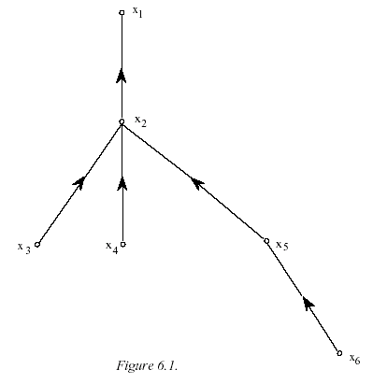
Removing term independence
In general, index terms aren’t independent
Dependencies can be complex
van Rijsbergen (1979) proposed model of simple tree dependencies
Each term dependent on one other
In 1970s, estimation problems held back success of this model

Slide 51
Food for thought
Think through the differences between standard tf.idf and the probabilistic retrieval model in the first iteration
Think through the retrieval process of probabilistic model similar to vector space model

Slide 52
Good and Bad News
Standard Vector Space Model
Empirical for the most part; success measured by results
Few properties provable
Probabilistic Model Advantages
Based on a firm theoretical foundation
Theoretically justified optimal ranking scheme
Disadvantages
Making the initial guess to get V
Binary word-in-doc weights (not using term frequencies)
Independence of terms (can be alleviated)
Amount of computation
Has never worked convincingly better in practice

Slide 53
BM25 (Okapi system) – Robertson et al.
Consider tf, qtf, document length
Doc. length
Normalization:
boost short
documents
TF factors
k1, k2, k3, b: parameters
qtf: query term frequency
dl: document length
avdl: average document length

Slide 54
Pivoted document length normalization (Singhal et al. SIGIR’96)
Document length normalization
Weight(t,D) = tf*idf
Cosine normalization: 1/|D|
Normalizatio by max weight: 0.5+0.5*w(t,D)/max{w(t’,D)}

Slide 55
Document Length Normalization (Singhal)
Sometimes, additional normalizations e.g. length to boost longer documents:
Probability
of relevance
slope
pivot
Probability of retrieval
Doc. length

Slide 56
Regression models
Extract a set of features from document (and query)
Define a function to predict the probability of its relevance
Learn the function on a set of training data (with relevance judgments)

Slide 57
Probability of Relevance
Document
Query
X1,X2,X3,X4
feature vector
Ranking Formula
Probability
of relevance

Slide 58
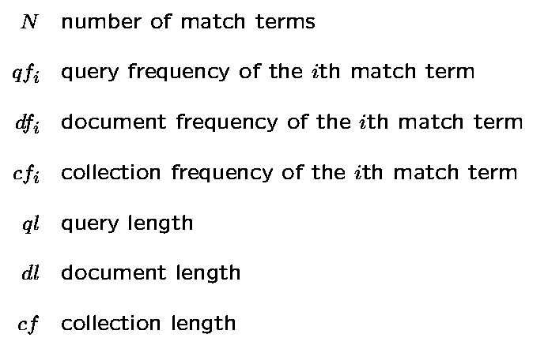
Regression model (Berkeley – Chen and Frey)

Slide 59
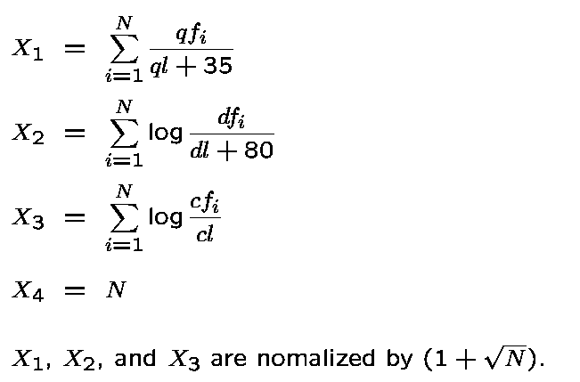
Relevance Features

Slide 60
Sample Document/Query Feature Vector
Relevance Features
X1
0.0031
0.0429
0.0430
0.0195
0.0856
X2
-2.406
-9.796
-6.342
-9.768
-7.375
X3
-3.223
-15.55
-9.921
-15.096
-12.477
X4
1
8
4
6
5
Relevance value
1
1
1
0
0
Representing one document/query
pair in the training set

Slide 61
Probabilistic Model: Supervised Training
Training Data Set:
Document/Query Pairs
with known relevance value.
1. Model training: estimate the
unknown model parameters using
training data set.
Model: Logistic Regression
Unknown parameters: b1,b2,b3, b4
Test Data Set:
New document/query
pairs
2. Using the estimated parameters
to predict relevance value for a
new pair of document and query.

Slide 62
Logistic Regression Method
Model: The log odds of the relevance dependent
variable is a linear combination of the independent
feature variables.
relevance
variable
feature
variables
Task: Find the optimal coefficients
Method: Use statistical software package such as S-plus to fit the model to a training data set.

Slide 63
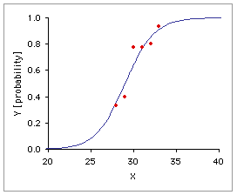
Logistic regression
The function to learn: f(z):
The variable z is usually defined as
x_{i} = feature variables
β_{i}=parameters/coefficients

Slide 64
Document Ranking Formula
N is the number of matching terms between document D and
query Q.
Notes:
Berkeley document ranking formula developed by W. Cooper, F. Gey, and others at TREC-2.

Slide 65
Discussions
Usually, terms are considered to be independent
algorithm independent from computer
computer architecture: 2 independent dimensions
Different theoretical foundations (assumptions) for IR
Boolean model:
Used in specialized area
Not appropriate for general search alone – often used as a pre-filtering
Vector space model:
Robust
Good experimental results
Probabilistic models:
Difficulty to estimate probabilities accurately
Modified version (BM25) – excellent results
Regression models:
Need training data
Widely used (in a different form) in web search
Learning to rank (a later lecture)
More recent model on statistical language modeling (robust model relying on a large amount of data – next lecture)

