Slide 1
Information Retrieval –
Language models for IR
From Manning and Raghavan’s course
[Borrows slides from Viktor Lavrenko and Chengxiang Zhai]

Slide 2
Recap
Traditional models
  Boolean model
  Vector space model
  Probabilistic models
Today
  IR using statistical language models

Slide 3
Principle of statistical language modeling
Goal: create a statistical model so that one can calculate the probability of a sequence of words s = w1, w2,…, wn in a language.
General approach:
Training corpus
s
Probabilities of the observed elements
P(s)

Slide 4
Examples of utilization
Speech recognition
  Training corpus = signals + words
  probabilities: P(word|signal), P(word2|word1)
  Utilization: signals sequence of words
Statistical tagging
  Training corpus = words + tags (n, v)
  Probabilities: P(word|tag), P(tag2|tag1)
  Utilization: sentence sequence of tags

Slide 5
Stochastic Language Models
A statistical model for generating text
  Probability distribution over strings in a given language
M
P ( | M )
= P ( | M )
P ( | M, )
P ( | M, )
P ( | M, )

Slide 6
Prob. of a sequence of words
Elements to be estimated:
If hi is too long, one cannot observe (hi, wi) in the training corpus, and (hi, wi) is hard generalize
Solution: limit the length of hi

Slide 7
n-grams
Limit hi to n-1 preceding words
Most used cases
  Uni-gram:
  Bi-gram:
  Tri-gram:

Slide 8
Unigram and higher-order models
Unigram Language Models
Bigram (generally, n-gram) Language Models
P ( )
= P ( )
P ( | )
P ( | )
P ( | )
Easy.
Effective!
P ( ) P ( ) P ( ) P ( )
P ( ) P ( | ) P ( | ) P ( | )

Slide 9
Estimation
History: short long
modeling: coarse refined
Estimation: easy difficult
Maximum likelihood estimation MLE
  If (hi mi) is not observed in training corpus,
  P(wi|hi)=0 → (hi mi) coud still be possible in the language
  Solution: smoothing

Slide 10
Smoothing
Goal: assign a low probability to words or n-grams not observed in the training corpus
P
MLE
smoothed
word

Slide 11
Smoothing methods
n-gram: α
Change the freq. of occurrences
  Laplace smoothing (add-one):
  Good-Turing
  change the freq. r to r*
  nr = no. of n-grams of freq. r
    →redistribute the total count of words of frequency r+1 to words of frequency r

Slide 12
Smoothing (cont’d)
Combine a model with a lower-order model
  Backoff (Katz)
  Interpolation (Jelinek-Mercer)
In IR, combine doc. with corpus

Slide 13
Standard Probabilistic IR
Information need
d1
matching
d2
query
…
dn
document collection

Slide 14
IR based on Language Model (LM)
Information need
d1
generation
d2
query
…
…
A query generation process
  For an information need, imagine an ideal document
  Imagine what words could appear in that document
  Formulate a query using those words
dn
document collection

Slide 15
Stochastic Language Models
Models probability of generating strings in the language (commonly all strings over alphabet ∑)
Model M
0.2 the
0.1 a
0.01 man
0.01 woman
0.03 said
0.02 likes
…
the
man
likes
the
woman
0.2
0.01
0.02
0.2
0.01
multiply
P(s | M) = 0.00000008

Slide 16
Stochastic Language Models
Model probability of generating any string
Model M1
Model M2
0.2 the
0.0001 class
0.03 sayst
0.02 pleaseth
0.1 yon
0.01 maiden
0.0001 woman
0.2 the
0.01 class
0.0001 sayst
0.0001 pleaseth
0.0001 yon
0.0005 maiden
0.01 woman
the
class
pleaseth
yon
maiden
0.2
0.01
0.0001
0.0001
0.0005
0.2
0.0001
0.02
0.1
0.01
P(s|M2) > P(s|M1)

Slide 17
Using Language Models in IR
Treat each document as the basis for a model (e.g., unigram sufficient statistics)
Rank document d based on P(d | q)
P(d | q) = P(q | d) x P(d) / P(q)
  P(q) is the same for all documents, so ignore
  P(d) [the prior] is often treated as the same for all d
    But we could use criteria like authority, length, genre
  P(q | d) is the probability of q given d’s model
Very general formal approach

Slide 18
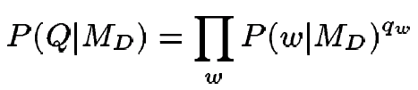
Language Models for IR
Language Modeling Approaches
  Attempt to model query generation process
  Documents are ranked by the probability that a query would be observed as a random sample from the respective document model
    Multinomial approach

Slide 19
Retrieval based on probabilistic LM
Treat the generation of queries as a random process.
Approach
  Infer a language model for each document.
  Estimate the probability of generating the query according to each of these models.
  Rank the documents according to these probabilities.
  Usually a unigram estimate of words is used

Slide 20
Retrieval based on probabilistic LM
Intuition
  Users …
    Have a reasonable idea of terms that are likely to occur in documents of interest.
    They will choose query terms that distinguish these documents from others in the collection.
Collection statistics …
  Are integral parts of the language model.
  Are not used heuristically as in many other approaches.
    In theory. In practice, there’s usually some wiggle room for empirically set parameters

Slide 21
Query generation probability (1)
Ranking formula
The probability of producing the query given the language model of document d using MLE is:
Unigram assumption:
Given a particular language model,
the query terms occur independently
: language model of document d
: raw tf of term t in document d
: total number of tokens in document d

Slide 22
Insufficient data
Zero probability
  May not wish to assign a probability of zero to a document that is missing one or more of the query terms [gives conjunction semantics]
General approach
  A non-occurring term is possible, but no more likely than would be expected by chance in the collection.
  If ,
: raw collection size(total number of tokens in the collection)
: raw count of term t in the collection

Slide 23
Insufficient data
Zero probabilities spell disaster
  We need to smooth probabilities
    Discount nonzero probabilities
    Give some probability mass to unseen things
There’s a wide space of approaches to smoothing probability distributions to deal with this problem, such as adding 1, ½ or ε to counts, Dirichlet priors, discounting, and interpolation
A simple idea that works well in practice is to use a mixture between the document multinomial and the collection multinomial distribution

Slide 24
Mixture model
P(w|d) = λP_{mle}(w|M_{d}) + (1 – λ)P_{mle}(w|M_{c})
Mixes the probability from the document with the general collection frequency of the word.
Correctly setting λ is very important
A high value of lambda makes the search “conjunctive-like” – suitable for short queries
A low value is more suitable for long queries
Can tune λ to optimize performance
  Perhaps make it dependent on document size (cf. Dirichlet prior or Witten-Bell smoothing)

Slide 25
Basic mixture model summary
General formulation of the LM for IR
  The user has a document in mind, and generates the query from this document.
  The equation represents the probability that the document that the user had in mind was in fact this one.
general language model
individual-document model

Slide 26
Example
Document collection (2 documents)
  d₁: Xerox reports a profit but revenue is down
  d₂: Lucent narrows quarter loss but revenue decreases further
Model: MLE unigram from documents; λ = ½
Query: revenue down
  P(Q|d₁) = [(1/8 + 2/16)/2] x [(1/8 + 1/16)/2]
  = 1/8 x 3/32 = 3/256
  P(Q|d₂) = [(1/8 + 2/16)/2] x [(0 + 1/16)/2]
  = 1/8 x 1/32 = 1/256
Ranking: d₁ > d₂

Slide 27
Dirichlet smoothing
Modify term frequency:
  Terms observed in a document
  Terms not observed in a document (hidden terms)
    Distribution according to the collection
The use of collection model is influenced by document length (different from interpolation)
Experiments: more robust than interpolation
  μ can vary in a quite large range o produce good results

Slide 28
Effect of smoothing?
Redistribution uniformly/according to collection
Tsunami ocean Asia computer nat.disaster …

Slide 29
Ponte and Croft Experiments
Data
  TREC topics 202-250 on TREC disks 2 and 3
    Natural language queries consisting of one sentence each
  TREC topics 51-100 on TREC disk 3 using the concept fields
    Lists of good terms
<num>Number: 054
<dom>Domain: International Economics
<title>Topic: Satellite Launch Contracts
<desc>Description:
… </desc>
<con>Concept(s):
Contract, agreement
Launch vehicle, rocket, payload, satellite
Launch services, … </con>

Slide 30
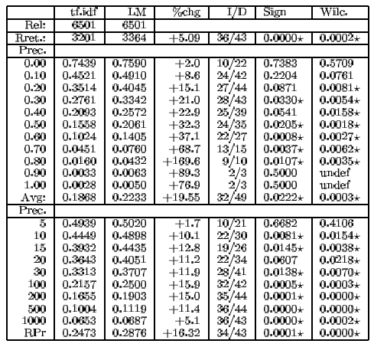
Precision/recall results 202-250

Slide 31
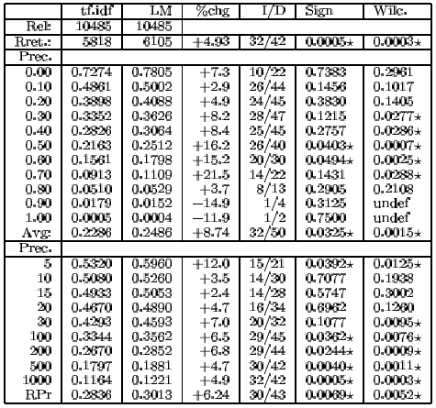
Precision/recall results 51-100

Slide 32
LM vs. Prob. Model for IR
The main difference is whether “Relevance” figures explicitly in the model or not
  LM approach attempts to do away with modeling relevance
LM approach asssumes that documents and expressions of information problems are of the same type
Computationally tractable, intuitively appealing

Slide 33
LM vs. Prob. Model for IR
Problems of basic LM approach
  Assumption of equivalence between document and information problem representation is unrealistic
  Very simple models of language
  Can’t easily accommodate phrases, passages, Boolean operators
Several extensions
  putting relevance back into the model,
  query expansion
  term dependencies,
  etc.

Slide 34
Alternative Models of Text Generation
Searcher
Query Model
Query
Is this the same model?
Writer
Doc Model
Doc

Slide 35
Model Comparison
Estimate query and document models and compare
Suitable measure is KL divergence D(Q_{m}||D_{m})
  equivalent to query-likelihood approach if simple empirical distribution used for query model (why?)
More general risk minimization framework has been proposed
  Zhai and Lafferty 2001
Better results than query-likelihood

Slide 36
Another view of model divergence
Query
D1
?
D2
Query model
Document model

Slide 37
Comparison With Vector Space
There’s some relation to traditional tf.idf models:
  (unscaled) term frequency is directly in model
  the probabilities do length normalization of term frequencies
  the effect of doing a mixture with overall collection frequencies is a little like idf: terms rare in the general collection but common in some documents will have a greater influence on the ranking

Slide 38
Comparaison: LM v.s. tf*idf
idf
Log P(Q|D) ~ VSM with tf*idf and document length normalization
Smoothing ~ idf + length normalization

Slide 39
Comparison With Vector Space
Similar in some ways
  Term weights based on frequency
  Terms often used as if they were independent
  Inverse document/collection frequency used
  Some form of length normalization useful
Different in others
  Based on probability rather than similarity
    Intuitions are probabilistic rather than geometric
  Details of use of document length and term, document, and collection frequency differ

Slide 40
LM vs. vector space model
tf*idf
q_{i}
log P_{ML}(q_{i}|D)
Smoothed
log P(q_{i}|D)
-∞

Slide 41
Uniform penalty?
tf*idf
Penalize more on specific terms
Less specific
q_{i}
log P_{ML}(q_{i}|D)
Smoothed
log P(qi|D)
Uniform penalty
-∞

Slide 42
Resources
J.M. Ponte and W.B. Croft. 1998. A language modeling approach to information retrieval. In SIGIR 21.
D. Hiemstra. 1998. A linguistically motivated probabilistic model of information retrieval. ECDL 2, pp. 569–584.
A. Berger and J. Lafferty. 1999. Information retrieval as statistical translation. SIGIR 22, pp. 222–229.
D.R.H. Miller, T. Leek, and R.M. Schwartz. 1999. A hidden Markov model information retrieval system. SIGIR 22, pp. 214–221.
Chengxiang Zhai, Statistical language models for information retrieval, in the series of Synthesis Lectures on Human Language Technologies, Morgan & Claypool, 2009
[Several relevant newer papers at SIGIR 2000–now.]
Workshop on Language Modeling and Information Retrieval, CMU 2001. http://la.lti.cs.cmu.edu/callan/Workshops/lmir01/ .
The Lemur Toolkit for Language Modeling and Information Retrieval. http://www-2.cs.cmu.edu/~lemur/ . CMU/Umass LM and IR system in C(++), currently actively developed.

